Slide 1


SRI KRISHNA COLLEGE OF ENGINEERING AND TECHNOLOGY
KUNIYAMUTHUR, COIMBATORE-8
DEPARTMENT OF ELECTRICAL AND ELECTRONICS ENGINEERING
(Accredited by NBA)
FIRST REVIEW
SMART HYDROPONIC SYSTEM
TEAM MEMBERS
YUVARAJ S 19EUEE159
SHIVA SANKAR M M 19EUEE122
WASIM AKRAM B 19EUEE157
THANGA PANDIAN N 19EUEE144
SUPERVISOR
Ms. R. GEETHAMANI
Assistant Professor/EEE

Slide 2
PROBLEM STATEMENT
The growing population is witnessing an increasing demand for food and water and this system would pave way for great productivity in the food as well as in water industries. Hydroponic farming is highly profitable. It is an example of high yield just in a small place in any season or weather condition. Hydroponic vegetables are highly accurate and balanced in fiber, minerals, and vitamins. It is the first method of doing soil-less farming/cultivation

Slide 3
INTRODUCTION
Agriculture is the science or practice of farming to cultivate crops and raise animals to create useful products for humans. People began to travel from rural regions where agriculture was practiced to places where these industries were located due to the exponential expansion in population over a short period of time and the development of various different industries. This resulted in the construction of cities, where other similar businesses were established, and this phenomenon known as urbanization resulted in many people performing occupations other than agriculture. As a result, subsistence agriculture could no longer support the population, and the agricultural sector required development.

Slide 4
The design is being implemented using a Microcontroller, sensors for real-time data, Esp-01 module, and MQTT that were chosen during component selection based on required parameters. The data which are being derived from the sensors are Temperature, PH value, Electricity conductivity, Moisture, Humidity, nitrogen, potassium, phosphorus content, and a Water flow sensor which makes sure that the water is being supplied at the appropriate time.
The system aims to improvise Hydroponics farming and also for greater and faster production of food with water conservation. Future projects may also include Artificial Intelligence algorithms which can enhance the credibility of this system.

Slide 5
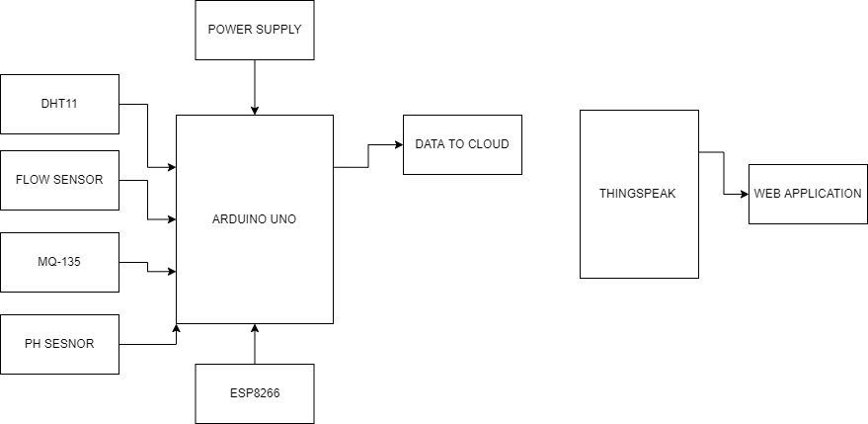
BLOCK DIAGRAM

Slide 6
The overall block diagram displays the flow of the system in which the Microcontroller plays a crucial part in collecting all of the data from the sensor and allowing the user to recognize their data and make adjustments accordingly and this is done with the help of ESP-01 module and MQTT which plays an important role in transferring real-time data from microcontroller to the user end. Several sensors are used to achieve the desired results, including the DHT11 sensor, the Flow sensor, MQ135, the Ph sensor, and NPK sensor which ensures that the essential elements in the aqueous solution are supplied to the plants at the appropriate time. All of these sensors aid in keeping track of the supply of all essential elements for the growth of plants. The web application shows all the related data which is derived from the sensors and makes this system much more efficient. The ESP device enables internet connectivity for the transfer of sensor data to the end users. The MQTT protocol helps in sending all these data in packets to the web application via the cloud where the user gets to analyze and read all the real-time data of the sensors being set up in order to monitor whether the essential elements necessary for the growth of the plants are properly maintained.

Slide 7
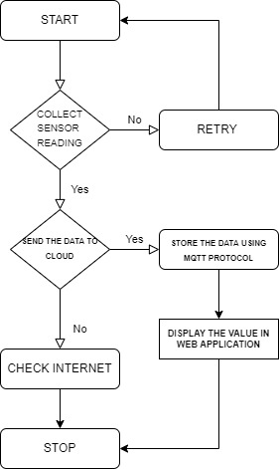
WORKING PRINCIPLE

Slide 8
The system's operation is divided into three primary components: input data, cloud server, and output data. The intelligent hydroponics system is made up of three primary components: input data, cloud server (monitoring and managing), and output data. Starting with the input data, since IOT stands for the internet of things, a collection of objects, mainly sensors, connect with each other over a network, hence an IOT system requires a group of sensors. The smart hydroponics system is made up of many sensors that collect data such as temperature, humidity, pH level, nitrogen content, electrical conductivity, moisture, water flow, and nitrogen, potassium, and phosphorus content in the aqueous solution.
The internet of things is defined as the capacity to monitor and view data in real-time while also sending data and controlling settings through a network. To accomplish this, an MQTT, which stands for MQ Telemetry Transport, is a lightweight message protocol built for low bandwidth, high latency networks. The output data from the sensors is seen via the web application that has been created for the end user. The obtained output data is utilized to analyze the proper demands of the plants and crops that are being cultivated.

Slide 9
The system is programmed in a way that the data collected from the microcontrollers is being viewed and if the data isn’t collected it tries on collecting all the pieces of information. The data are being collected from the Microcontroller and the ESP device which pays the way for the transfer of data through the internet. If the data collected could not reach the cloud then the internet connectivity is being verified. The MQTT protocol once gets the data, stores the data, and then transfers it to the desired given location which in this case is a web application where the end user verifies the level of essentials present in the nutrient solution for the growth of their plants or crops.
The web application pays the way for the end user to acknowledge the level of essential as well as the system alerts the end user when there is an imbalance in the level of the nutrients in the aqueous solution or if any disturbances occur due to the environmental factors through an Email. With this email facility, the end user could easily track which element has an imbalance in their threshold value

Slide 10
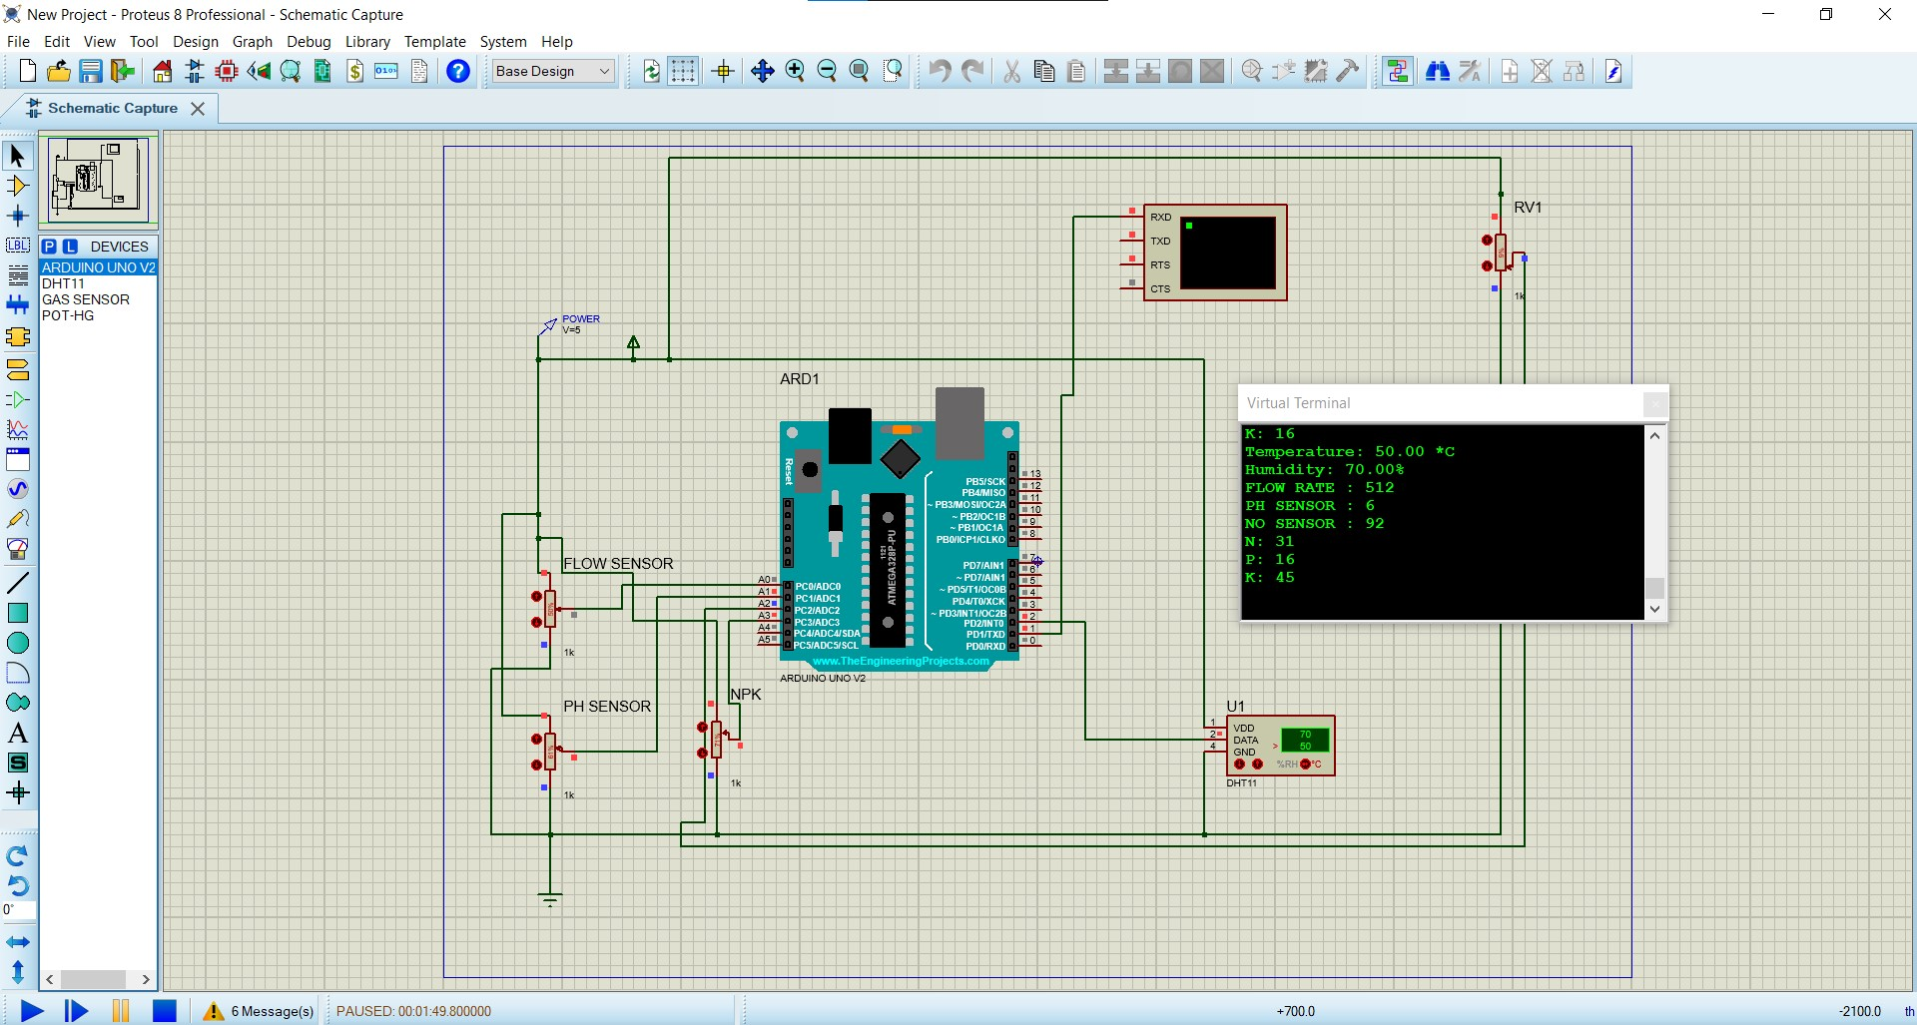
SIMULATION

Slide 11
The virtual terminals depict all the values of the data being processed in the Arduino. The above simulation enables the user to visualize the real-time project and its outcomes. The parameters that have been manifested through the virtual terminal in the above simulation are Temperature, PH value, Electricity conductivity, Moisture, Humidity, nitrogen, potassium, phosphorus, and water flow rate.
The above simulation is based on the data collected for a hydroponics framing of a tomato which needs its temperature to be from 50 degrees to 75-degree Fahrenheit, with an ideal value of PH between 6.0 to 6.5, the humidity of 65% to 85%, Nitrogen is said to be 140 PPM, Phosphorus 50 PPM, Potassium 350 PPM and also can be with a ratio of 10-5-14. The above simulation also indicates the water flow rate of 512 liters per hour.

Slide 12
LITERATURE REVIEW
S.No | AUTHOR & YEAR | TITLE OF THE PAPER | REMARKS
1 | T. Namgyel, S. Siyang, C. Khunarak, T. Pobkrut, J. Norbu, T. Chaiyasit and T. Kerdcharoen, (2018) | IoT-based hydroponic system with supplementary LED light for smart home farming of lettuce | Provides knowledge about hydroponic framing.
2 | Falmata Modu, Adam Adam, Farouq Aliyu, Audu Mabu, and Mahdi Musa(2020) | A Survey of Smart Hydroponic Systems | Gives the knowledge about various methods in Hydroponics framing

Slide 13
REFERENCES
Kunyanuth Kularbphettong, Udomlux Ampant, and Nutthaphol Kongrodj, "An Automated Hydroponics System Based on Mobile Application," International Journal of Information and Education Technology, Vol. 9, No. 8, August 2019.
Srinidhi H K, Shreenidhi H S, and Vishnu G S, "Smart Hydroponics system integrating with IoT and machine learning algorithm," 2020 5th International Conference on Recent Trends on Electronics, Information, Communication & Technology (RTEICT-2020), November 12th & 13th 2020.

Slide 14
THANK YOU

